Slide 1

Influenza viral clearance
Phrutsamon Wongnak
on behalf of the PLATCOV and AD ASTRA teams
Evaluating anti-infective drugs, Theo Murphy Meeting
Manchester, 2-3 December 2024

Slide 2
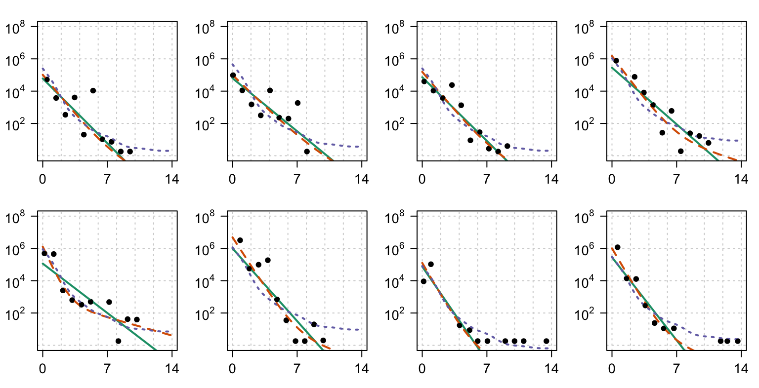
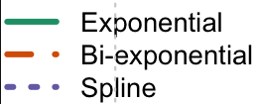
Lesson learned from SARS-CoV-2
Viral clearance in acute respiratory infections
RNA copies per ml
Biphasic decay
Time since peak (days)
Limit of detection (LOD)
Watson et al., (2022) Antimicrob. Agents Chemother.

Slide 3
How do we quantitate antiviral activities for SARS-CoV-2?
We measure the slope of the initial phase of log-linear decline in oropharyngeal swab eluate viral RNA copies (Ct) over time.
This provides a rate
(which can also be expressed as a half-life).
The drug effect is the difference in the slopes between the drug arms and the contemporaneous no-drug arms
log

Slide 4
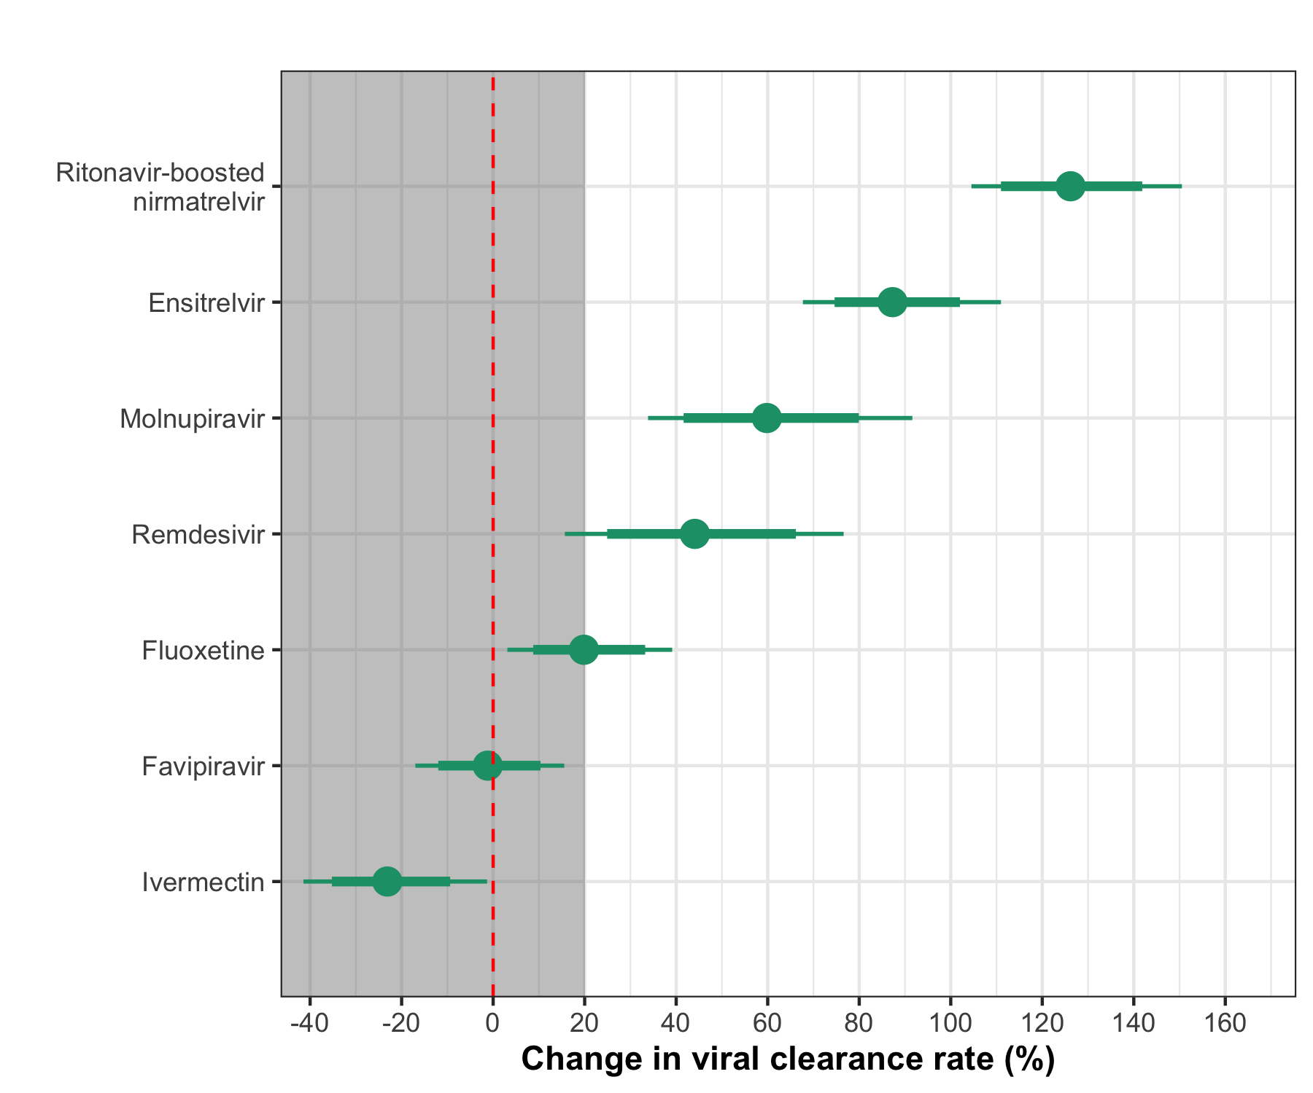
Can this approach be applied to other infections? Influenza?
Head-to-head comparison for antiviral activities

Slide 5
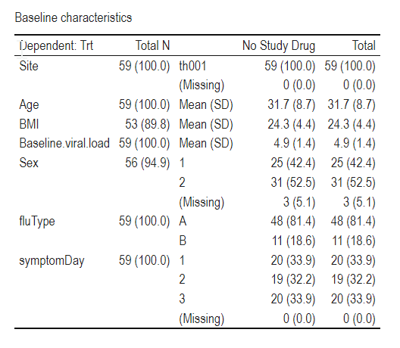
AD ASTRA trial
Data
Date: From 28 Feb 2023 to 25 Aug 2024
Arm: No study drug
Patient with PCR data: 72 (Flu A: 60; Flu B: 12)
mITT population: 59 (Flu A: 48; Flu B: 11); excluded 13
> 250 mean genomes/mL on D0
Having PCR data from D0 to D3
Randomisation to date: Thailand (82); All sites (90)

Slide 6
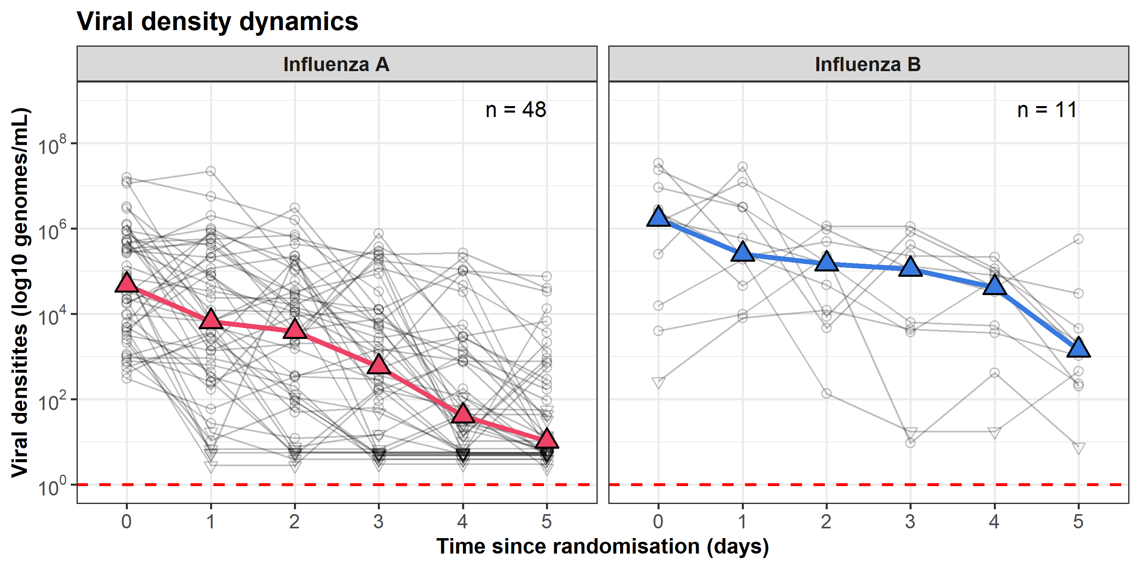

Slide 7
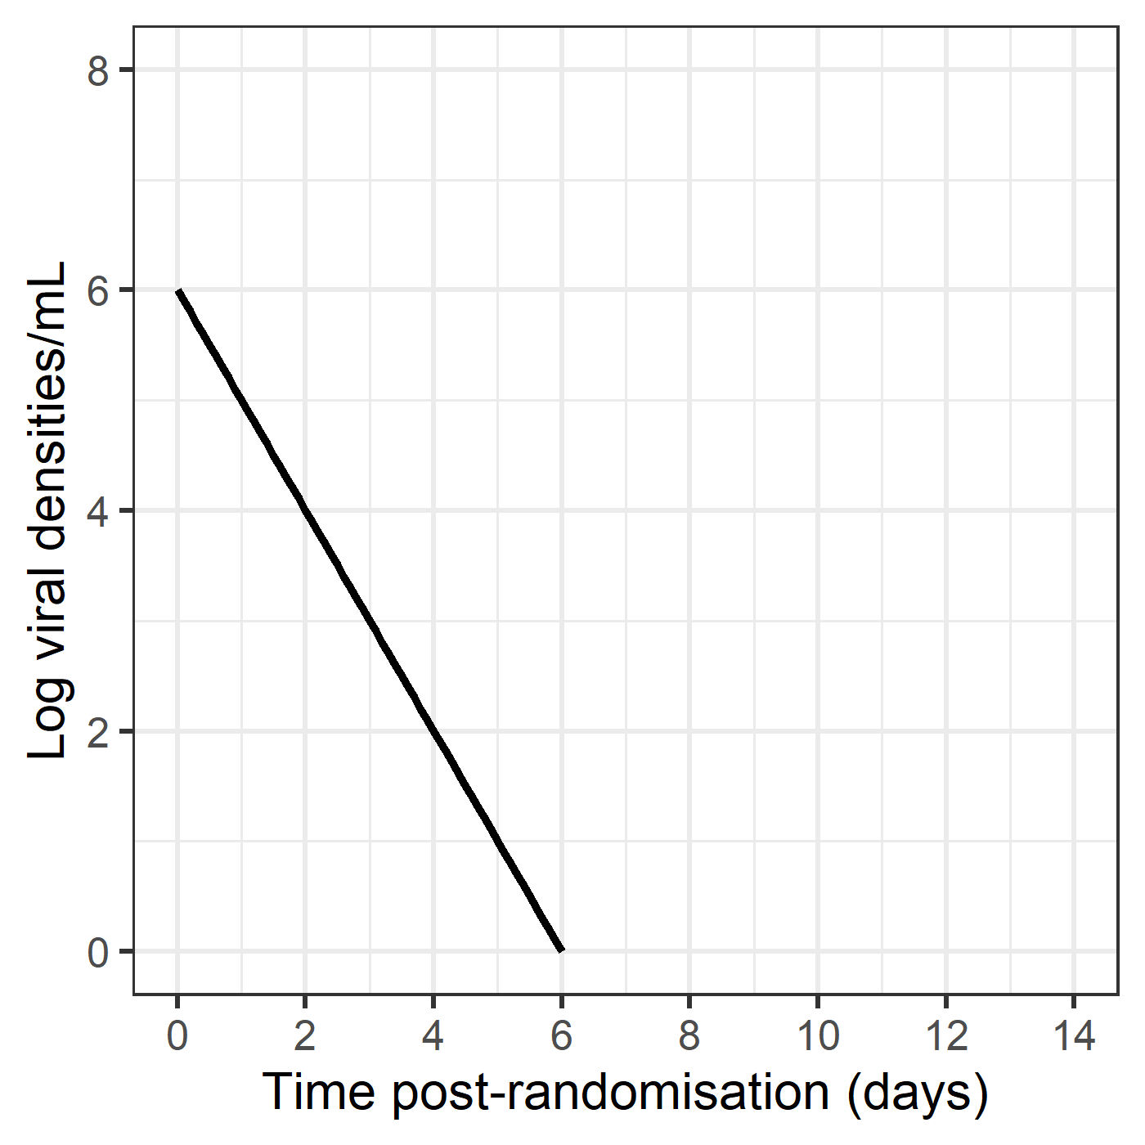
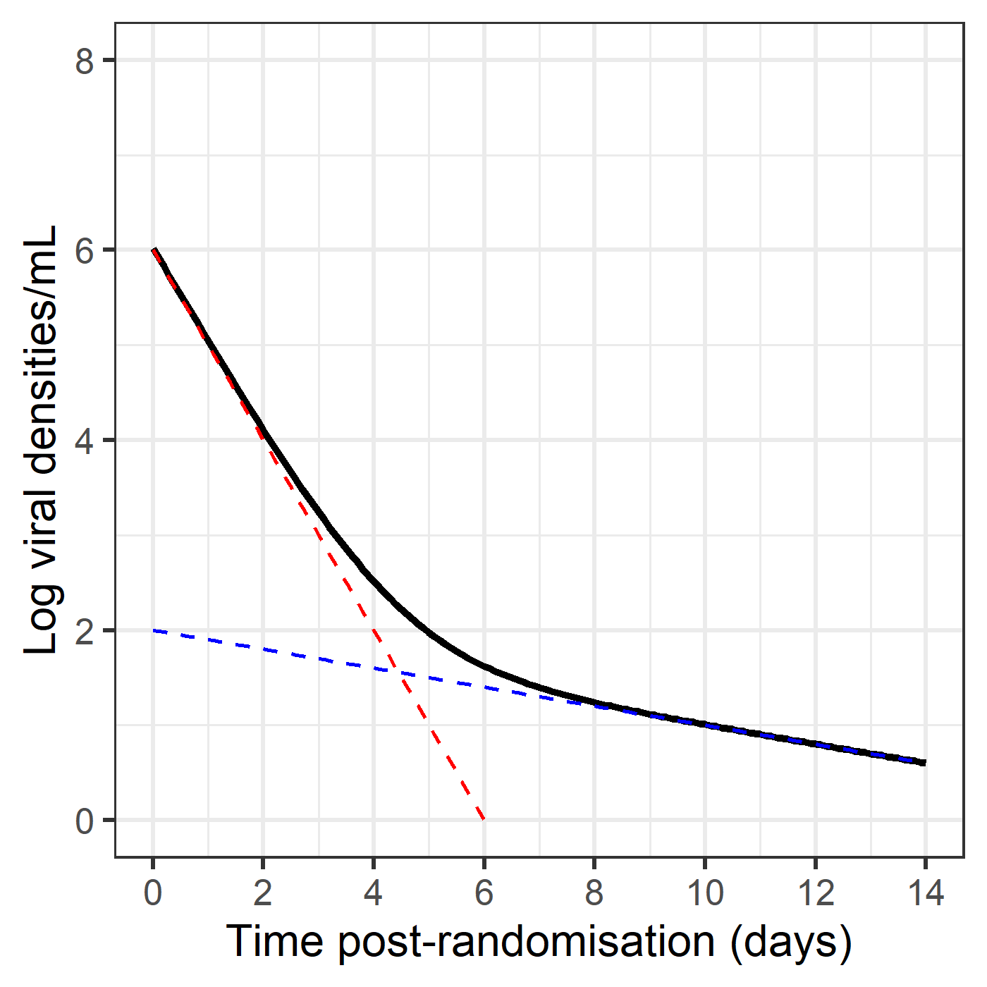
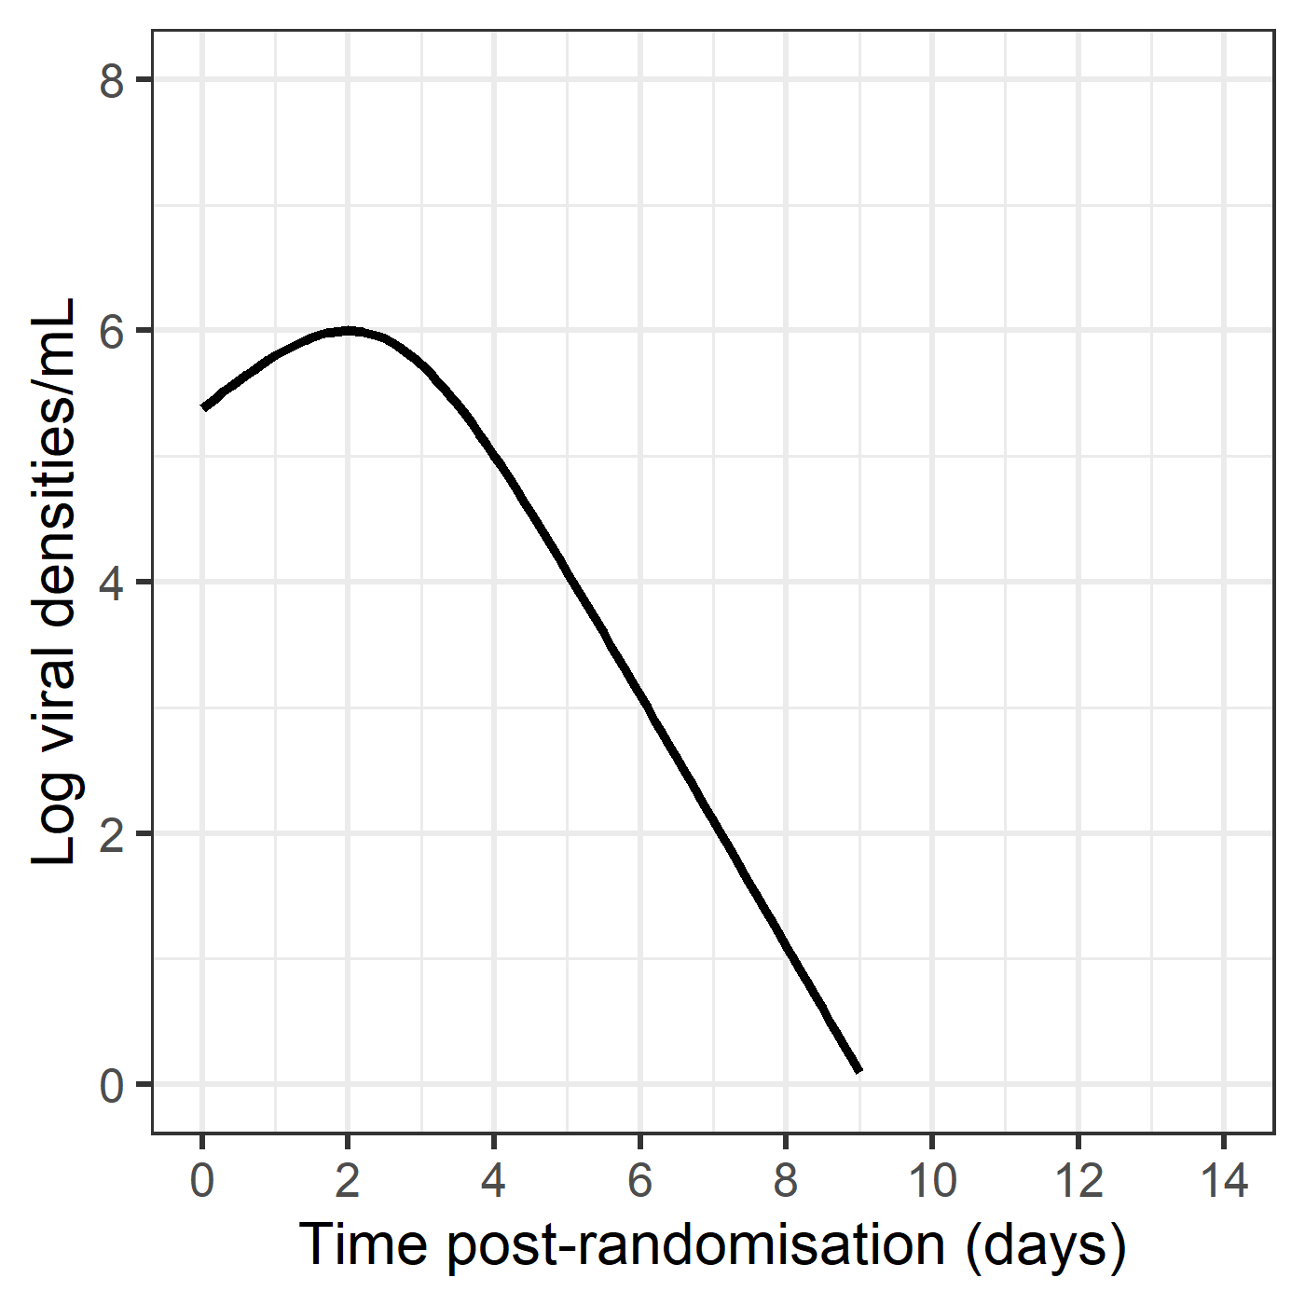
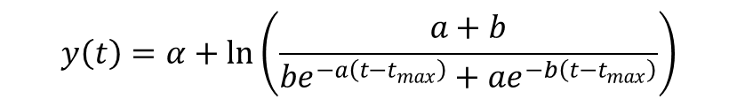
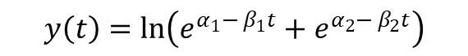

Single exponential model
Bi-exponential model
Up-down
model
$$y\left(t\right)=α+\ln\left(\frac{a+b}{be^{−a\left(t−t_{max}\right)}+ae^{−b\left(t−t_{max}\right)}}\right)$$
$$y\left(t\right)=α_{0}+ β_{0}t$$
$$y\left(t\right)=\ln\left(e^{α_{1}− β_{1}t}+e^{α_{2}− β_{2}t}\right)$$

Slide 8
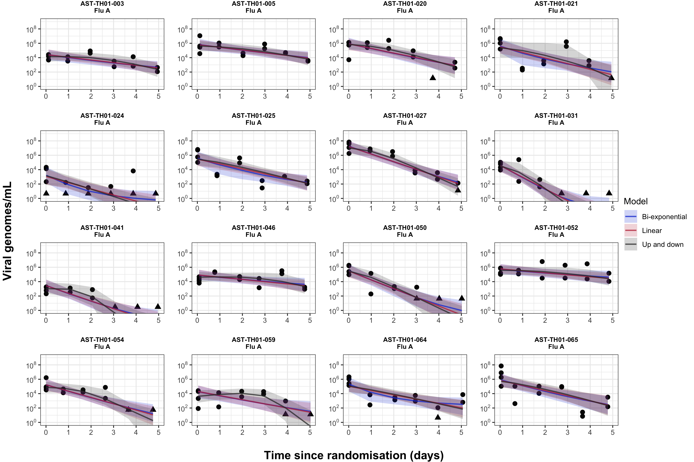

Slide 9
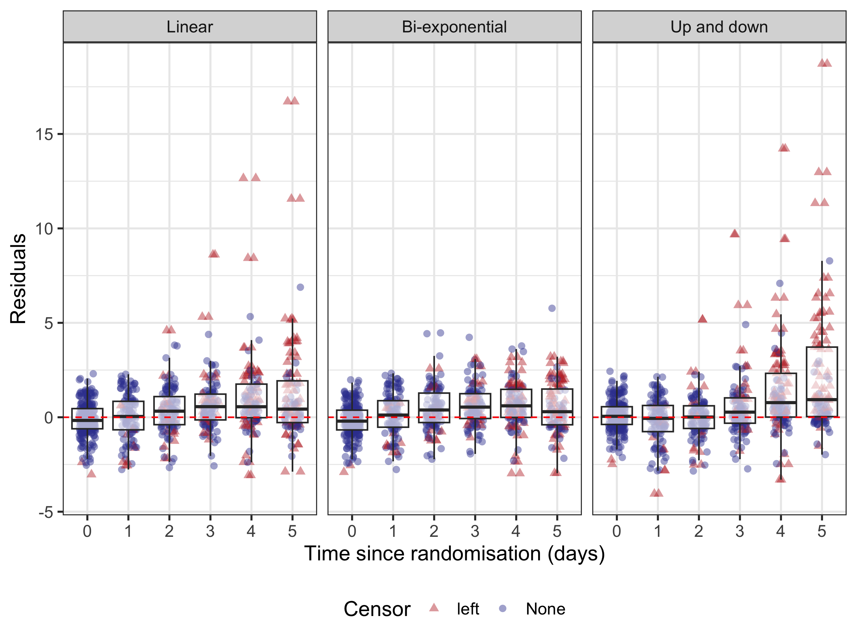
Residuals of fitted models

Slide 10
Simulations and optimization of trial design
Single exponential decay model
Influenza A data (n = 48)
Simulations:
Treatment effects (20%, 40%, 60%, 80%, 100%)
Sample size (40, 80, 120, 160, 200, 240)
100 replications per condition
Comparing with
Negative control (0% treatment effect)
Positive control (60% treatment effect)

Slide 11
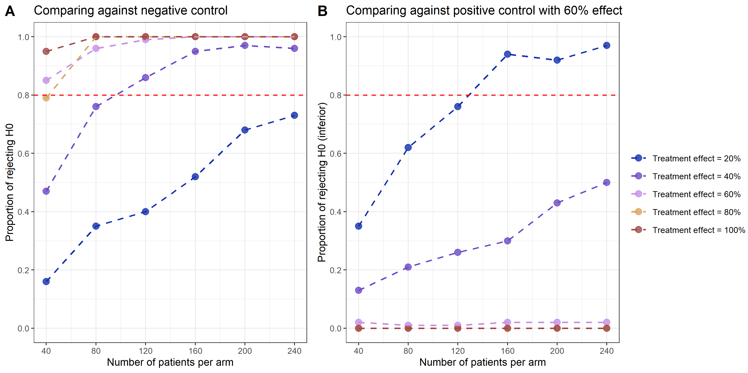

Slide 12
Generalizing to other acute infections
Population-level viral clearance rates
Population-level baseline viral densities
Variability of viral clearance rates among the population
Variability of baseline viral density among the population
Precisions on viral density measurement

Slide 13
THANK YOU

